Slide 1
Chapter Two
Process Management

Slide 2
A PROCESS
A process is an instance of a program running in a computer.
A program by itself is not a process; a program is a passive entity, such as a file containing a list of instructions stored on disks. (often called an executable file)
A program becomes a process when an executable file is loaded into memory and executed.

Slide 3
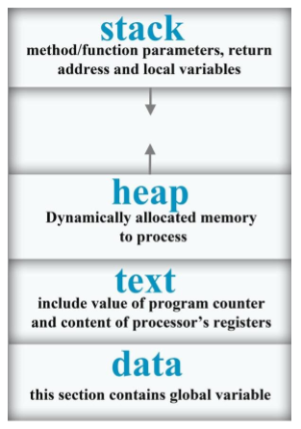
Parts of a Process
When a program is loaded into a memory and it become a process , it can be divided into four sections :

Slide 4
Parts of a process
Stack: It contain temporary data such as method/ function parameters return address and local variables.
Heap: This is dynamically allocated memory to a process during its run time.
Text: This includes the current activity represented by the value of program counter and the contents of the processor’s registers.
Data: This section contain the global and static variable

Slide 5
Program
Program is an executable file containing the set of instructions written to perform a specific job on our computer.
E.g. chrome.exe is an executable file containing the set of instruction written so that we can view web page.

Slide 6
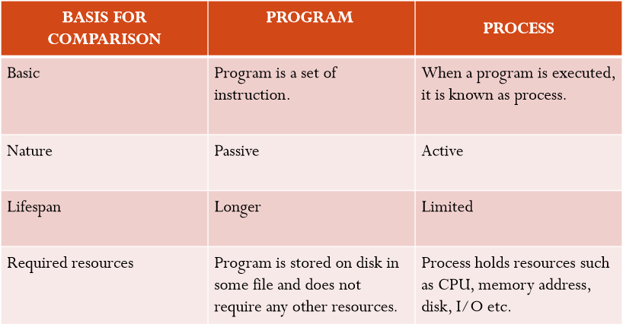
Process Vs Program

Slide 7
Process creation
Parent process creates children processes, which, in turn create other processes, forming a tree of processes .
Generally, process identified and managed via a process identifier (pid).
When an operating system is booted, often several processes are created. Some of these are foreground processes, that is, processes that interact with (human) users and perform work for them.
Note
A Daemon is a computer program that runs as a Hardware activity, or other programs by performing some task.
In UNIX there is only one system call to create a new process: fork().

Slide 8
Process states (Process life cycle)
Processes in the operating system can be in any of the following states:
NEW- The process is being created.
READY- The process is waiting to be assigned to a processor.
RUNNING- Instructions are being executed.
WAITING- The process is waiting for some event to occur(such as an I/O completion or reception of a signal).
TERMINATED- The process has finished execution.

Slide 9
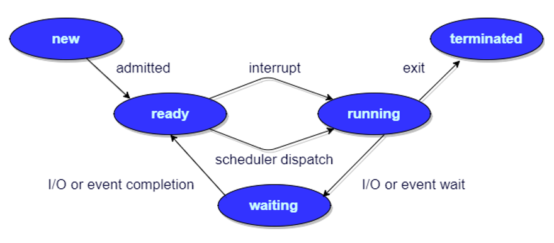
Process states (process life cycle)

Slide 10
Process Control Block (PCB)
Process Control Block (PCB, also called Task Controlling Block, Entry of the Process Table, Task Struct, or Switch frame)
It is a data structure in the operating system kernel containing the information needed to manage the scheduling of a particular process.
The PCB is "the manifestation(expression) of a process in an operating system."

Slide 11
Role of PCB
The role or work of process control block (PCB) in process management is that it can access or modified by most OS utilities including those are involved with memory, scheduling, and input / output resource access.
The process control blocks give the information of the current state of the operating system.
Process control blocks perform data structuring for processes.
Pointers to other process control blocks inside any process control block allows the creation of those queues of processes in various scheduling states.

Slide 12
Information in PCB
The following are the various information that is contained by process control block:
Naming the process
State of the process
Resources allocated to the process
Memory allocated to the process
Scheduling information
Input / output devices associated with process

Slide 13
Components of PCB
The following are the various components that are associated with the process control block PCB:
Process ID
Process State
Program counter
Register Information
Scheduling information
Memory related information
Accounting information
Status information related to input/output

Slide 14
Components of PCB
Process ID:
It is an identification number that uniquely identifies the processes of computer system.
In computer system there are various process running simultaneously and each process has its unique ID. This Id helps system in scheduling the processes. This Id is provided by the process control block.
Process state:
Process control block is used to define the process state of any process. In other words, process control block refers the states of the processes.
The process state of any process can be New, running, waiting, executing, blocked, suspended, terminated.

Slide 15
Components of a PCB
Program counter:
Program counter is used to point to the address of the next instruction to be executed in any process. This is also managed by the process control block.
Register Information:
This information is comprising with the various registers, such as index and stack that are associated with the process. This information is also managed by the process control block.

Slide 16
Components of a PCB
Scheduling information:
Scheduling information is used to set the priority of different processes. This is very useful information which is set by the process control block. In computer system there were many processes running simultaneously and each process have its priority. The priority of primary feature of RAM is higher than other secondary features.
Memory related information:
This section of the process control block comprises of page and segment tables. It also stores the data contained in base and limit registers.

Slide 17
Components of a PCB
Accounting information:
This section of process control block stores the details relate to central processing unit (CPU) utilization and execution time of a process.
Status information related to input / output:
This section of process control block stores the details pertaining to resource utilization and file opened during the process execution.

Slide 18
Process Table
The operating system maintains a table called process table, which stores the process control blocks related to all the processes.
The process table is a data structure maintained by the operating system to facilitate context switching and scheduling, and other activities discussed later.
Each entry in the table, often called a context block, contains information about a process such as process name and state (discussed above), priority (discussed above), registers, and a semaphore it may be waiting on.

Slide 19
Thread
A thread is the smallest unit of processing that can be performed in an OS.
In most modern operating systems, a thread exists within a process - that is, a single process may contain multiple threads.
It shares with other threads belonging to the same process its code section, data section, and other operating system resources, such as open files and signals.
If a process has multiple thread of control, it can perform more than one task at a time.

Slide 20
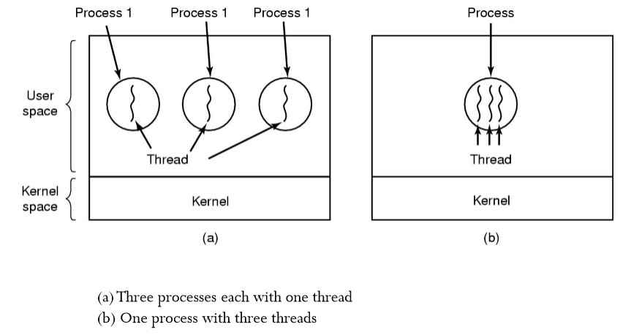
Threads

Slide 21
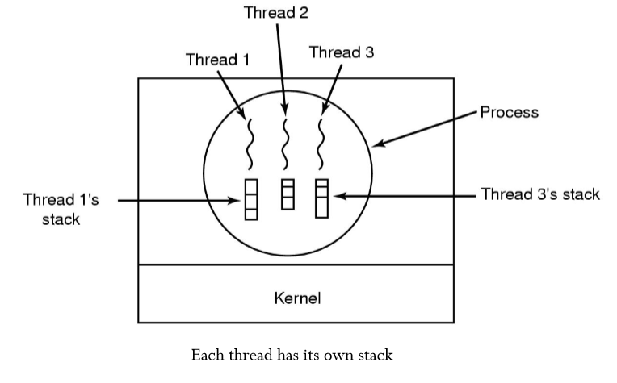
Threads

Slide 22
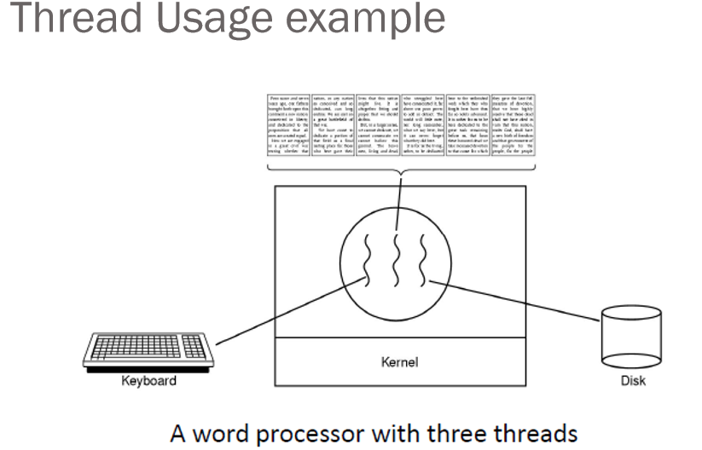

Slide 23
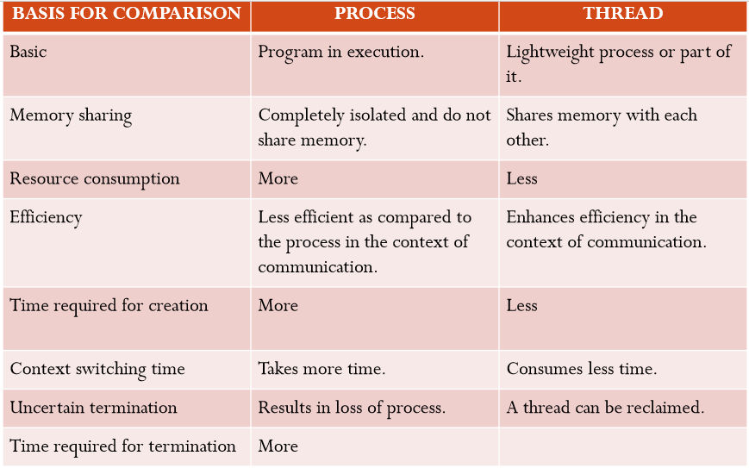
Process vs Threads

Slide 24
Properties of a Thread:
Only one system call can create more than one thread (Lightweight process).
Threads share data and information.
Threads shares instruction, global and heap regions but has its own individual stack and registers.
Thread management consumes no or fewer system calls as the communication between threads can be achieved using shared memory.
The isolation property of the process increases its overhead in terms of resource consumption.

Slide 25
Types of Threads
There are two types of threads:
User Threads
Kernel Threads

Slide 26
User Level thread (ULT)
Is implemented in the user level library, they are not created using the system calls. Kernel doesn’t know about the user level thread and manages them as if they were single-threaded processes.
Advantages of ULT
Can be implemented on an OS that doesn't support multithreading.
Simple representation since thread has only program counter, register set, stack space.
Simple to create since no intervention of kernel.
Thread switching is fast since no OS calls need to be made.
Disadvantages of ULT
No or less co-ordination among the threads and Kernel.
If one thread causes a page fault, the entire process blocks.

Slide 27
Kernel Level Thread (KLT)
Kernel knows and manages the threads. Instead of thread table in each process, the kernel itself has thread table (a master one) that keeps track of all the threads in the system.
In addition kernel also maintains the traditional process table to keep track of the processes.
OS kernel provides system call to create and manage threads.

Slide 28
Advantages of KLT
Since kernel has full knowledge about the threads in the system, scheduler may decide to give more time to processes having large number of threads.
Good for applications that frequently block.
Disadvantages of KLT
Slow and inefficient.
It requires thread control block so it is an overhead.

Slide 29
Multithreading
Many software package that run on modern desktop PCs are multithreaded.
An application is implemented as a separate process with several threads of control.
A web browser might have one thread to display images or text while other thread retrieves data from the network.
A word-processor may have a thread for displaying graphics, another thread for reading the character entered by user through the keyboard, and a third thread for performing spelling and grammar checking in the background.

Slide 30
Why Multithreading
To perform several similar task such as a web server accepts client requests for web pages, images, sound, graphics etc.
To have several clients concurrently accessing a server. So if the web server runs on traditional single threaded process, it would be able to service only one client at a time.
The amount of time that the client might have to wait for its request to be serviced is enormous. One solution of this problem can be thought by creation of new process.

Slide 31
Benefits of Multi-threading
Responsiveness: Multithreaded interactive application continues to run even if part of it is blocked or performing a lengthy operation, thereby increasing the responsiveness to the user.
Resource Sharing: By default, threads share the memory and the resources of the process to which they belong.
It allows an application to have several different threads of activity within the same address space. These threads running in the same address space do not need a context switch.

Slide 32
Benefits of Multi-threading
Economy: Allocating memory and resources for each process creation is costly. Since thread shares the resources of the process to which they belong, it is more economical to create and context switch threads.
Shorter context switching time. Less overhead than running several processes doing the same task.
Utilization of multiprocessor architecture: The benefits of multi threading can be greatly increased in multiprocessor architecture, where threads may be running in parallel on different processors.
Multithreading on a multi-CPU increases concurrency.

Slide 33
Multithreading Model
The user threads must be mapped to kernel threads, by one of the following strategies:
Many to One Model
One to One Model
Many to Many Model

Slide 34
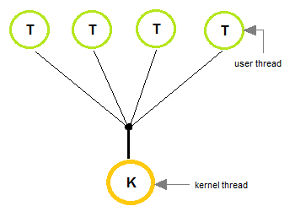
Many to One Model
In the many to one model, many user-level threads are all mapped onto a single kernel thread.
Thread management is handled by the thread library in user space, which is efficient in nature.

Slide 35
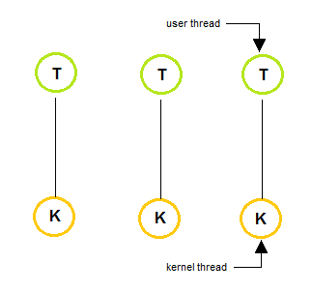
One to One Model
The one to one model creates a separate kernel thread to handle each and every user thread.
Most implementations of this model place a limit on how many threads can be created. Linux and Windows from 95 to XP implement the one-to one model for threads.

Slide 36
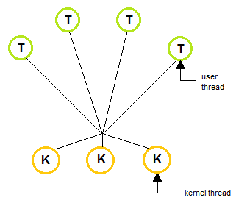
Many to Many Model
The many to many model multiplexes any number of user threads onto an equal or smaller number of kernel threads, combining the best features of the one-to-one and many-to one models.
Users can create any number of the threads. Blocking the kernel system calls does not block the entire process. Processes can be split across multiple processors.

Slide 37
Inter Process Communication
IPC is a mechanism that allows the exchange of data between processes.
Inter-process communication (IPC) is a set of techniques for the exchange of data among multiple threads in one or more processes.
Processes may be running on one or more computers connected by a network.
Processes executing concurrently in the operating system may be either independent process or co-operating process

Slide 38
Inter Process Communication
Independent process: A process is independent if it can't affect or be affected by another process.
Co-operating Process: A process is co-operating if it can affect other or be affected by the other process. Any process that shares data with other process is called cooperating process.

Slide 39
Reasons for providing an environment for process co-operation
Information sharing: Several users may be interested to access the same piece of information( for instance a shared file). We must allow concurrent access to such information.
Computation Speedup: To run the task faster we must breakup tasks into sub-tasks. Such that each of them will be executing in parallel to other, this can be achieved if there are multiple processing elements.
Modularity: Construct a system in a modular fashion which makes easier to deal with individual.
Convenience: Even an individual user may work on many tasks at the same time. For instance, a user may be editing, printing, and compiling in parallel.

Slide 40
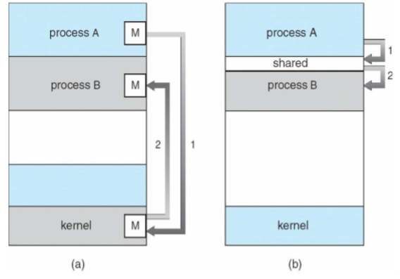
Fundamental ways of IPC
There are two fundamental ways of IPC;
Message Passing
Shared Memory

Slide 41
Shared Memory
Here a region of memory that is shared by co-operating process is established.
Processes can exchange the information by reading and writing data to the shared region.
Shared memory allows maximum speed and convenience of communication as it can be done at the speed of memory within the computer.
System calls are required only to establish shared memory regions.
Once shared memory is established no assistance from the kernel is required, all access are treated as routine memory access.

Slide 42
Message Passing
Communication takes place by means of messages exchanged between the co-operating process
Message passing is useful for exchanging the smaller amount of data.
Easier to implement than shared memory.
Slower than that of Shared memory as message passing system are typically implemented using system call
Which requires more time consuming task of Kernel intervention.

Slide 43
Race Condition
The situation where 2 or more processes are reading or writing some shared data, but not in proper sequence is called race Condition.
The final results depends on who runs precisely(accurately) when.

Slide 44
IPC: Critical Regions and solution
The part of the program where the shared memory is accessed that must not be concurrently accessed by more than one processes is called the critical region
Four conditions to provide mutual exclusion Or (Rules for avoiding Race Condition) Solution to Critical section problem:
No two processes simultaneously in critical region
No assumptions made about speeds or numbers of CPUs
No process running outside its critical region may block another process
No process must wait forever to enter its critical region
Notes:
Busy waiting
Continuously testing a variable until some value appears is called busy waiting.
If the entry is allowed, it executes else it sits in tight loop and waits.
Busy-waiting:
Consumption of CPU cycles while a thread is waiting for a lock
It is very inefficient
Can be avoided with a waiting queue

Slide 45
Semaphores
Semaphores are synchronization primitives used to control access to shared resources in a concurrent environment.
File and Record Locking: Semaphores can be employed to implement file and record locking. Processes use semaphores to indicate whether they have acquired a lock on a file or a specific record within a file.
A semaphore could have the value 0, indicating that no wakeup processes were saved, or some positive value if one or more wakeups were pending.
There are two operations, down (wait) and up (signal) (generalizations of sleep and wakeup, respectively).

Slide 46
Implementation of Semaphores
Semaphore Operations
Semaphores typically support two operations; ‘wait’ (or ‘P’) and ‘signal’ (or ‘V’).
‘wait’: Decrements the semaphore count. If the count is non-negative, the process continues; otherwise, it waits.
‘signal’: Increments the semaphore count, potentially waking up a waiting process.
Mutex (Mutual Exclusion): A binary semaphore can be used as a mutex to provide exclusive access to a shared resource.

Slide 47
Semaphore operations
Counting semaphore
Integer value can range over an unrestricted domain
Binary semaphore
Integer value can range only between 0 and 1
It can be simpler to implement
Also known as mutex locks, it provides mutual exclusion
Semaphore gives solution to n process.

Slide 48
Types of Semaphores
Full: For counting the number of slots that are full, initially 0
Empty: For counting the number of slots that are empty, initially equal to the no. of slots in the buffer.
Mutex: To make sure that the producer and consumer do not access the buffer at the same time, initially 1.

Slide 49
Advantages of semaphores
Processes do not busy wait while waiting for resources.
While waiting, they are in a "suspended'' state, allowing the CPU to perform other work.
Works on (shared memory) multiprocessor systems.
User controls synchronization.
Disadvantage of semaphores
Can only be invoked by processes not interrupt service routines because interrupt routines cannot block
User controls synchronization could mess up.

Slide 50
Message Passing
Inter process communication uses two primitives, send and receive.
They can easily be put into library procedures, such as
send(destination, &message);
receive(source, &message);
The former call sends a message to a given destination and the latter one receives a message from a given source.
If no message is available, the receiver can block until one arrives. Alternatively, it can return immediately with an error code.

Slide 51
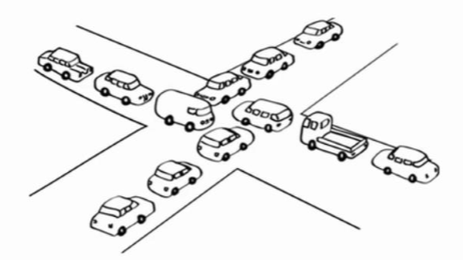
Deadlocks
A Deadlock is a situation where two or more processes are unable to proceed because each is waiting for the other to release a resource.
This is a situation where programs continue running indefinitely without making any progress.
Each program is waiting for an event that another process can cause.

Slide 52
Deadlocks
Prevention: Techniques involve ensuring that at least one of the necessary conditions for deadlock cannot hold. This may include resource allocation policies, careful resource ordering, or dynamically releasing resources.
Avoidance: This involves careful resource allocation based on resource state information. The system checks if a resource allocation would lead to a deadlock and only allows it if the system is in a safe state.
Detection: Periodic checks for circular wait, resource holding, and no preemption can be used to detect deadlocks. If detected, recovery mechanisms such as process termination or resource preemption can be applied.

Slide 53
Use of Signals, Pipes, and Shared Memory:
Signals: In Unix-like operating systems, signals are used for communication between processes. They can be used to notify a process that a particular event has occurred.
Pipes: Pipes provide a way for processes to communicate with each other. One process writes data to the pipe, and another process reads from it.
Shared Memory: Shared memory allows multiple processes to share a region of memory. This shared region can be used for communication between processes.

Slide 54
CPU Scheduling
The long-term scheduler:
Selects processes from this process pool and loads selected processes into memory for execution.
The short-term scheduler:
Selects the process to get the processor from among the processes which are already in memory.
The short-time scheduler will be executing frequently (mostly at least once every 10 milliseconds). So it has to be very fast in order to achieve a better processor utilization.
Medium term scheduler:
It can sometimes be good to reduce the degree of multiprogramming by removing processes from memory and storing them on disk.
These processes can then be reintroduced into memory by the medium-term scheduler.
This operation is also known as swapping. Swapping may be necessary to free memory.

Slide 55
Scheduling Criteria
Many criteria have been suggested for comparison of CPU scheduling algorithms.
CPU utilization: We have to keep the CPU as busy as possible.
Throughput: It is the measure of work in terms of number of process completed per unit time.
Turnaround Time: It is the sum of time periods spent in waiting to get into memory, waiting in ready queue, execution on the CPU and doing I/O. Waiting time plus the service time.
Turnaround time= Time of completion of job - Time of submission of job. (waiting time + service time or burst time)
Waiting time: Its the sum of periods waiting in the ready queue.
Response time: Response time is the amount of time it takes to start responding, not the time taken to output that response. In interactive system the turnaround time is not the best criteria.

Slide 56
The goals of CPU scheduling are
Fairness: Each process gets fair share of the CPU.
Efficiency: When CPU is 100% busy then efficiency is increased.
Response Time: Minimize the response time for interactive user.
Throughput: Maximizes jobs per given time period.
Waiting Time: Minimizes total time spent waiting in the ready queue.
Turn Around Time: Minimizes the time between submission and termination.
Notes:
Scheduling Criteria
The Operating System maintains the following important process scheduling queues −
Job queue − This queue keeps all the processes in the system.
Ready queue − This queue keeps a set of all processes residing in main memory, ready and waiting to execute. A new process is always put in this queue.
Device queues − The processes which are blocked due to unavailability of an I/O device constitute this queue.

Slide 57
Two-State Process Model
Two-state process model refers to running and non-running states which are described below.
Running. When a new process is created, it enters into the system as in the running state.
Not Running. Processes that are not running are kept in queue, waiting for their turn to execute. Each entry in the queue is a pointer to a particular process. Queue is implemented by using linked list.

Slide 58
Types of Scheduling
Preemptive Scheduling
Preemptive scheduling algorithm picks a process and lets it run for a maximum of some fixed time. If it is still running at the end of the time interval, it is suspended and the scheduler picks another process to run (if one is available).
Doing preemptive scheduling requires having a clock interrupt occur at the end of time interval to give control of the CPU back to the scheduler.
Non preemptive Scheduling
Non preemptive scheduling algorithm picks a process to run and then just lets it run until it blocks (either on I/O or waiting for another process) or until it voluntarily releases the CPU. Even if it runs for hours, it will not be forcibly suspended.

Slide 59
Dispatcher
A dispatcher is a special program which takes that process to the desired state/queue.
The dispatcher is the module that gives a process control over the CPU after it has been selected by the short-term scheduler. This function involves the following:
Switching context
Switching to user mode
Jumping to the proper location in the user program to restart that program

Slide 60
Scheduler
Schedulers are special system software which handle process scheduling in various ways.
Their main task is to select the jobs to be submitted into the system and to decide which process to run.
There are three types of Scheduler:
Long term (job) scheduler
Medium term scheduler
Short term (CPU) scheduler

Slide 61
Scheduling algorithms
Batch system scheduling
First come first served
Shortest job first
Shortest remaining time next
Interactive System Scheduling
Round Robin scheduling
Priority scheduling
Multiple queues

Slide 62
1. First come first served
FCFS is the simplest non-preemptive algorithm. Processes are assigned the CPU in the order they request it. That is the process that requests the CPU first is allocated the CPU first.
The implementation of FCFS is policy is managed with a FIFO(First in first out) queue.

Slide 63
First come first served
Advantages:
Easy to understand and program.
Equally fair.
Suitable specially for Batch Operating system.
Disadvantages:
FCFS is not suitable for time-sharing systems where it is important that each user should get the CPU for an equal amount of arrival time.

Slide 64
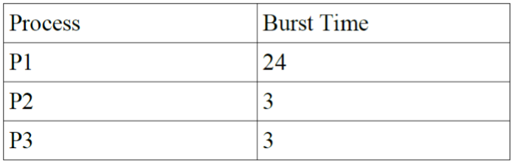
First come first served
Calculate the average waiting time if the processes arrive in the order of:
a). P1, P2, P3
b). P2, P3, P1

Slide 65


First come first served
a) The processes arrive the order P1, P2, P3. Let us assume they arrive in the same time at 0 ms in the system. We get the following Gantt chart.
Waiting time for P1= 0ms , for P2 = 24 ms for P3 = 27ms
Average waiting time: (0+24+27)/3= 17
b. ) If the process arrive in the order P2,P3, P1
Average waiting time: (0+3+6)/3=3.
Average waiting time vary substantially if the process CPU burst time vary greatly.

Slide 66
2. Shortest Job First
When several equally important jobs are sitting in the queue waiting to be started, the scheduler picks the shortest jobs first.
The disadvantages of this algorithm is the problem to know the length of time for which CPU is needed by a process.
The SJF is optimal when all the jobs are available simultaneously. The SJF is either preemptive or non preemptive.
Preemptive SJF scheduling is sometimes called Shortest Remaining Time First scheduling.
With this scheduling algorithms the scheduler always chooses the process whose remaining run time is shortest.
When a new job arrives its total time is compared to the current process remaining time. If the new job needs less time to finish than the current process, the current process is suspended and the new job is started.
This scheme allows new short jobs to get good service.

Slide 67
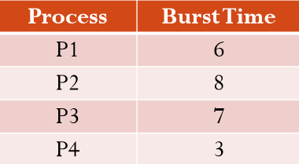
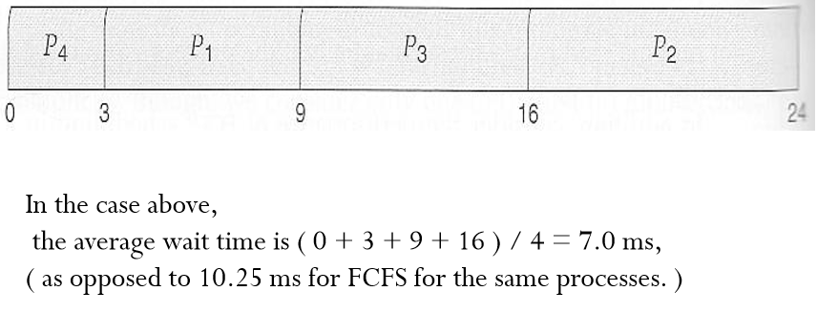
Shortest Job First
For example, the Gantt chart below is based upon the following CPU burst times, ( and the assumption that all jobs arrive at the same time. )

Slide 68
3. Shortest remaining time next (SRTF)
This Algorithm is the preemptive version of SJF scheduling.
In SRTF, the execution of the process can be stopped after certain amount of time. At the arrival of every process, the short term scheduler schedules the process with the least remaining burst time among the list of available processes and the running process.
Once all the processes are available in the ready queue, No preemption will be done and the algorithm will work as SJF scheduling.
The context of the process is saved in the Process Control Block when the process is removed from the execution and the next process is scheduled. This PCB is accessed on the next execution of this process.

Slide 69
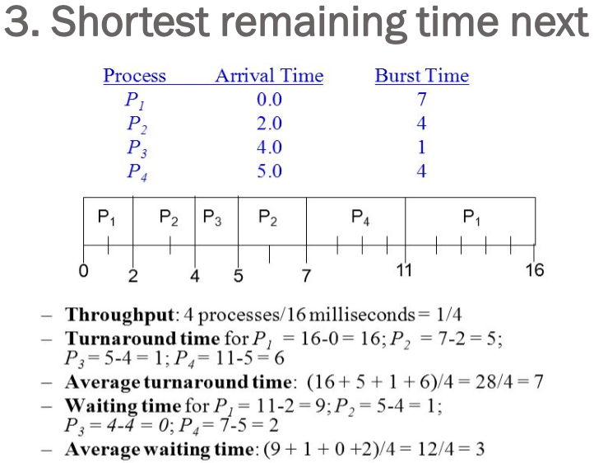

Slide 70
4. Round-Robin Scheduling Algorithms
One of the oldest, simplest, fairest and most widely used algorithm is round robin (RR).
In the round robin scheduling, processes are dispatched in a FIFO manner but are given a limited amount of CPU time called a time-slice or a quantum.
Round Robin Scheduling is preemptive (at the end of time-slice) therefore it is effective in timesharing environments in which the system needs to guarantee reasonable response times for interactive users.
Setting the quantum too short causes too many context switches and lower the CPU efficiency. On the other hand, setting the quantum too long may cause poor response time and approximates FCFS.
In any event, the average waiting time under round robin scheduling is on quite long.

Slide 71
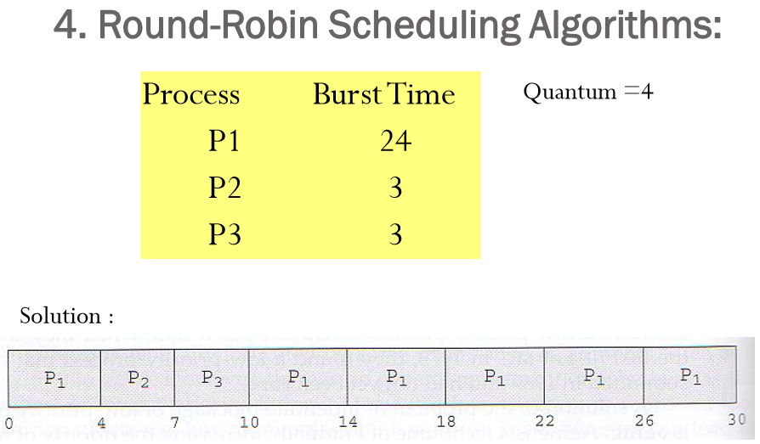

Slide 72
5. Priority Scheduling
A priority is associated with each process, and the CPU is allocated to the process with the highest priority.
Equal priority processes are scheduled in the FCFS order. Assigning priority
It is often convenient to group processes into priority classes and use priority scheduling among the classes but round-robin scheduling within each class.
Problems in Priority Scheduling:
Starvation: Low priority process may never execute.
Solution:
Aging: As time progress increase the priority of Process.

Slide 73
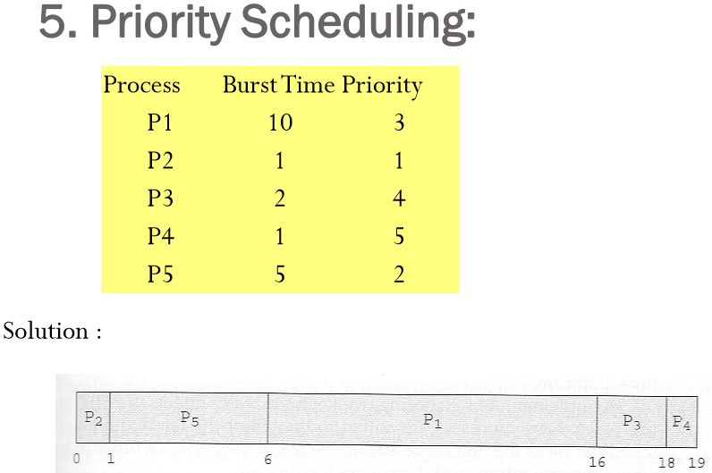

Slide 74
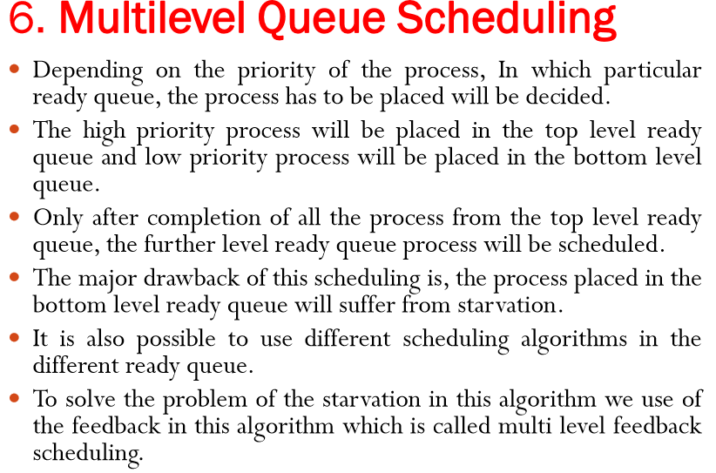

Slide 75
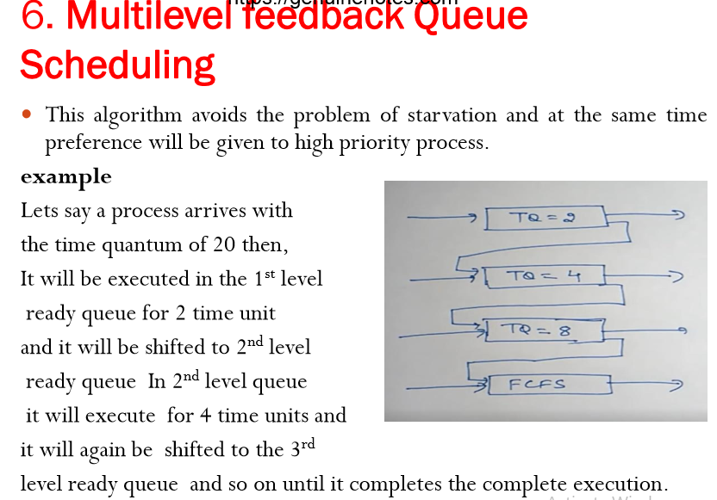

Slide 76
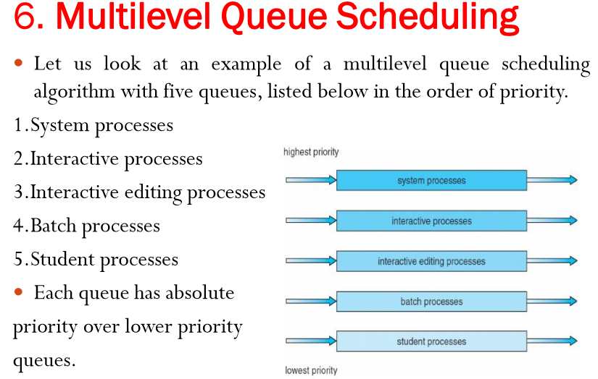

Slide 77
